Slide 1
SEARCH TECHNIQUES

Slide 2
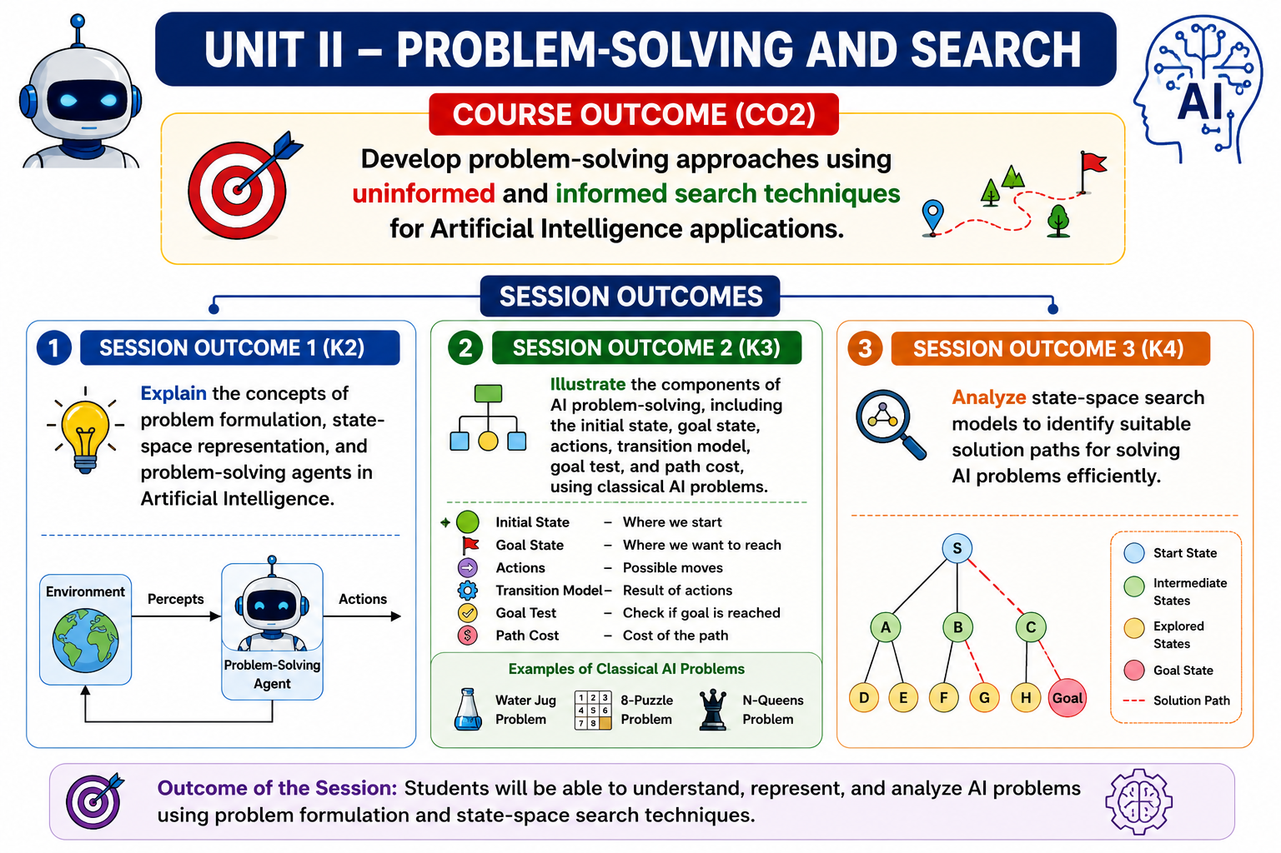

Slide 3
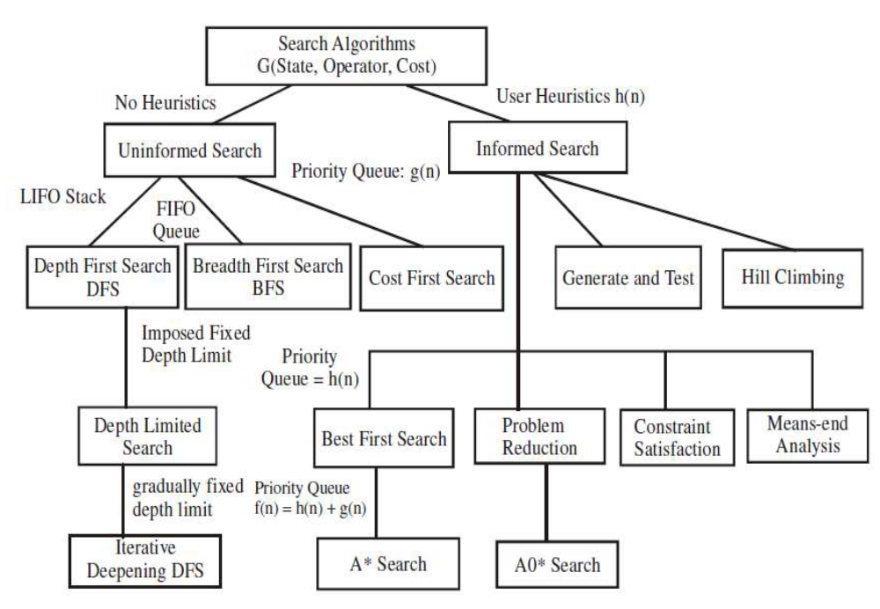
Different search algorithms

Slide 4
TYPES OF SEARCH TECHNIQUES
Uninformed search algorithms or Brute-force algorithms, search through the search space all possible candidates for the solution checking whether each candidate satisfies the problem’s statement.
Informed search algorithms use heuristic functions that are specific to the problem, apply them to guide the search through the search space to reduce the amount of time spent in searching.
The algorithms that use heuristic functions are called heuristic algorithms.
Heuristic algorithms are more efficient because they take advantage of feedback from the data to direct the search path.
Notes:
Uninformed Search Algorithms (also called blind search algorithms) are search strategies that do not have any domain-specific knowledge about the goal state's location — they only use the information available in the problem definition (initial state, actions, goal test, and cost).

Slide 5
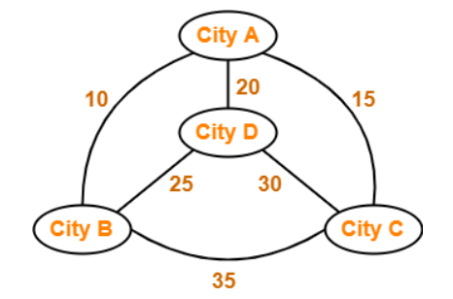
A good heuristic will make an informed search dramatically outperform any uninformed search:
Ex: Traveling Salesman Problem (TSP), where the goal is to find is a good solution instead of finding the best solution.

Slide 6
Uninformed Search Algorithms
Uninformed search is a class of general-purpose search algorithms which operates in brute force-way.
Uninformed Search Algorithms (also called blind search algorithms) are search strategies that do not have any domain-specific knowledge about the goal state's location — they only use the information available in the problem definition (initial state, actions, goal test, and cost).
They do not have additional information about state or search space other than how to traverse the tree, so it is also called blind search.
Important types of uninformed search algorithms:
  Breadth-first Search
  Depth-first Search
  Bidirectional Search

Slide 7
Example
Exploring an unfamiliar building in the dark, with no map or exit signs. You only know which doors are near you right now, and whether you've reached the exit — you can't tell which door is more likely to lead there.

Slide 8
Breadth-first search
Explore level by level: check everything one step away first, then everything two steps away, and so on — like ripples spreading out from a stone dropped in water.
Real-world example: Finding a person through your social network by asking your direct friends first, then your friends' friends, then friends of friends' friends — one whole "ring" at a time. This guarantees you find the closest connection first.

Slide 9
Breadth-first search
A Search strategy, in which the highest layer of a decision tree is searched completely before proceeding to the next layer is called Breadth-first search (BFS).
No viable solutions are omitted and therefore it is guaranteed that an optimal solution is found.
This strategy is often not feasible when the search space is large.
Algorithm
1. Create a variable called LIST and set it to be the starting state.
2. Loop until a goal state is found or LIST is empty, Do
a. Remove the first element from the LIST and call it E. If the LIST is empty, quit.
b. For every path each rule can match the state E, Do
(i) Apply the rule to generate a new state.
(ii) If the new state is a goal state, quit and return this state.
(iii) Otherwise, add the new state to the end of LIST.

Slide 10
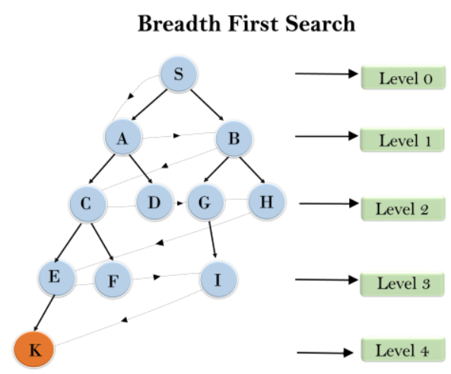
Example:
The traversing of the tree using BFS algorithm from the root node S to goal node K.
BFS search algorithm traverse in layers, so it will follow the path which is shown by the dotted arrow, and the traversed path will be:
S---> A--->B---->C--->D---->G--->H--->E---->F---->I---->K

Slide 11
Advantages
1. Guaranteed to find an optimal solution (in terms of shortest number of steps to reach the goal).
2. Can always find a goal node if one exists (complete).
Disadvantages
1. High storage requirement: exponential with tree depth.

Slide 12
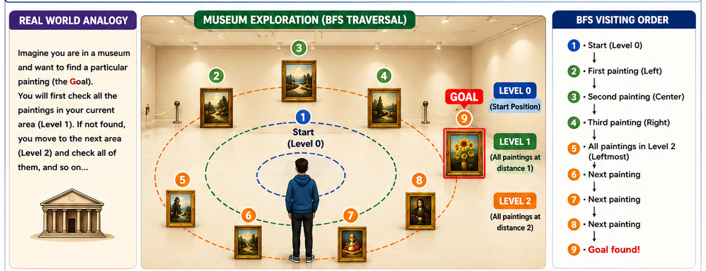

Slide 13
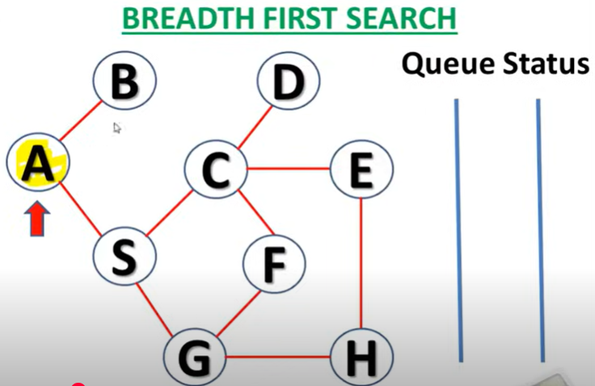
Output: A

Slide 14
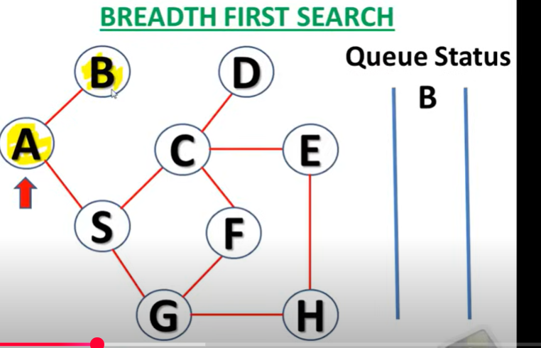
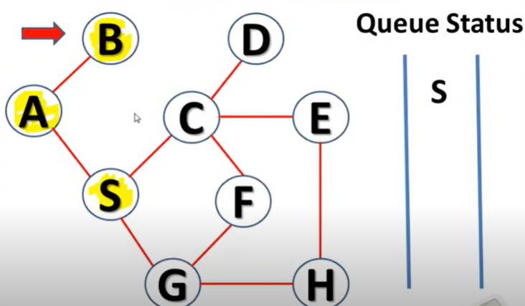
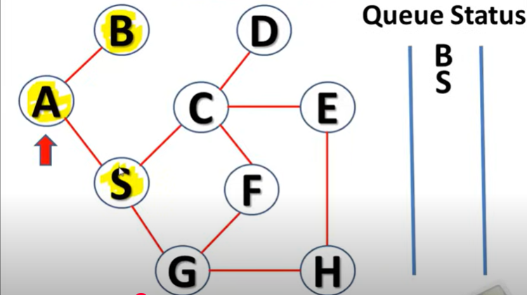
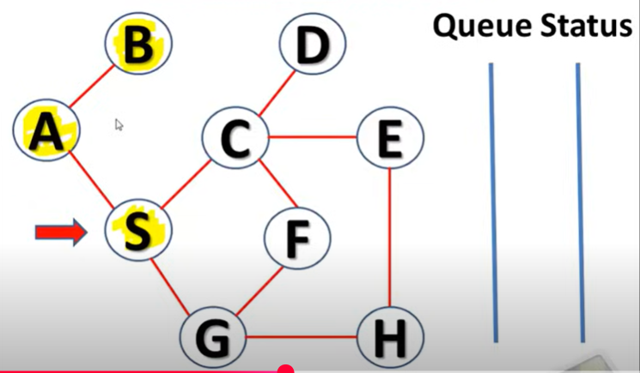
Output: ABS

Slide 15
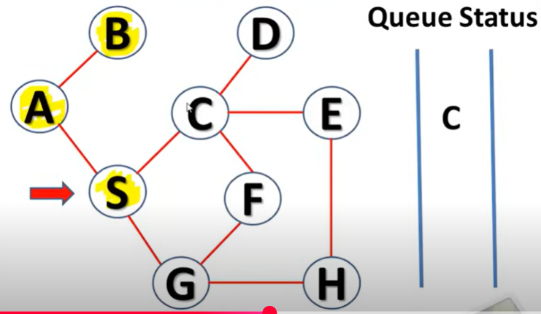
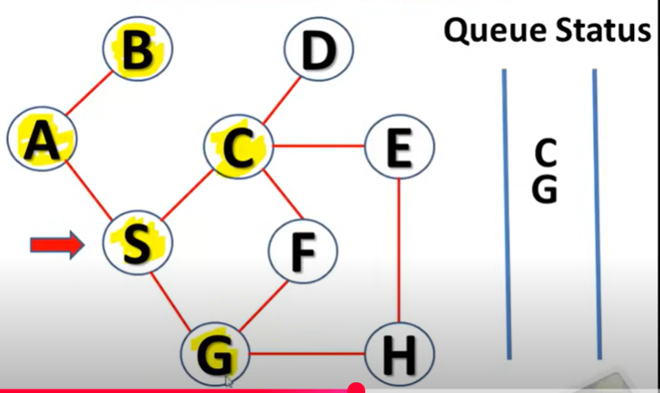
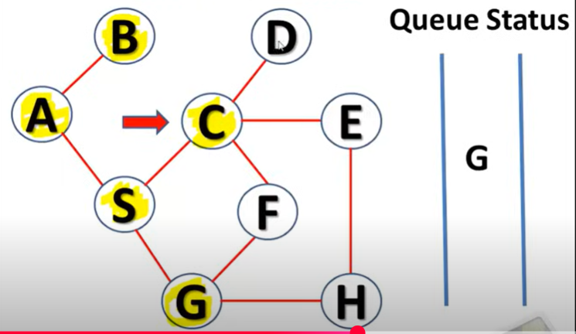
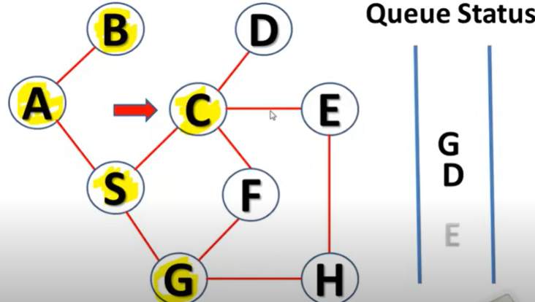
Output: ABSCGD

Slide 16
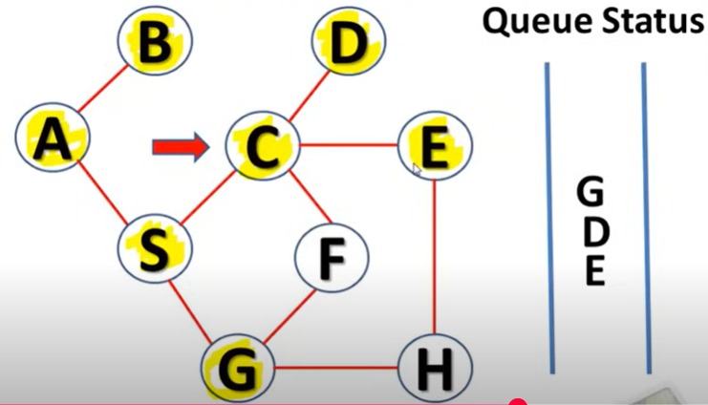
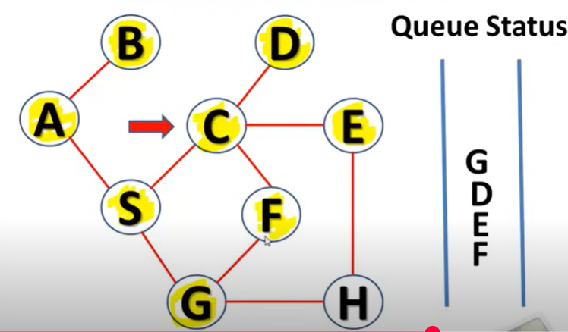
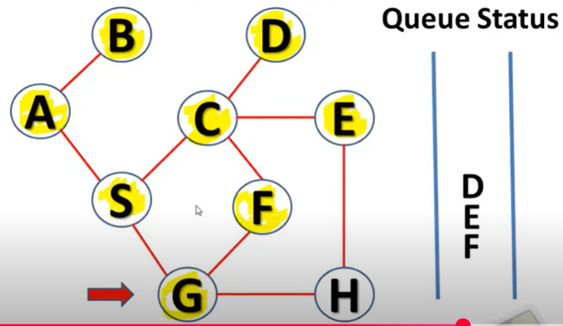
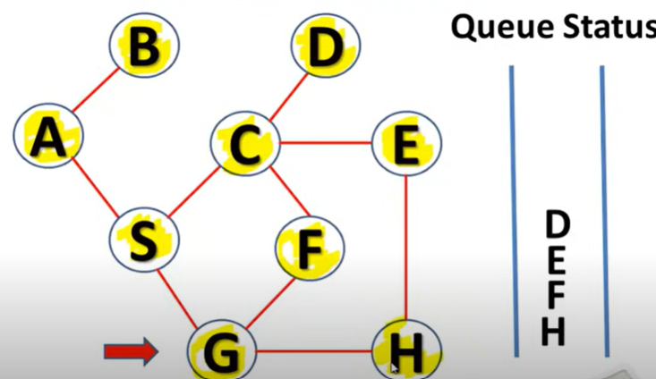
Output: ABSCGDEFH

Slide 17
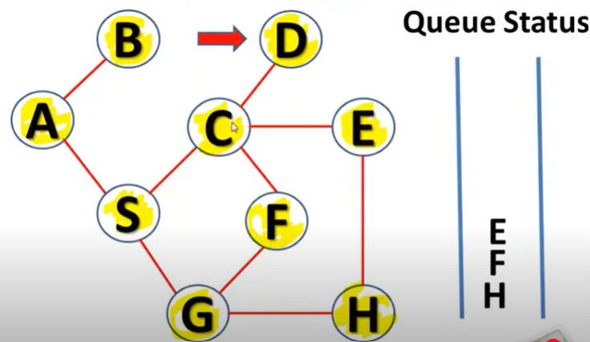
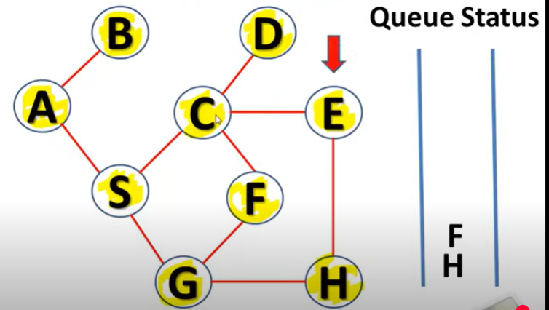
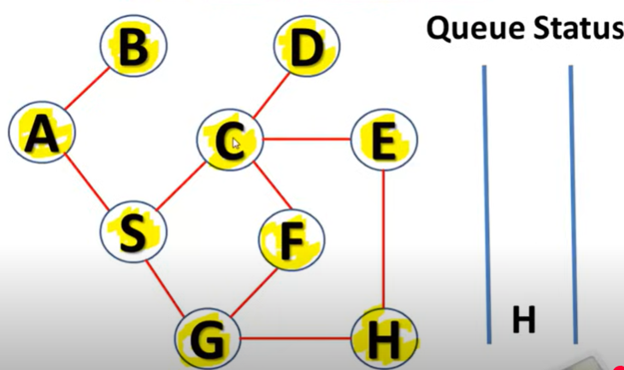
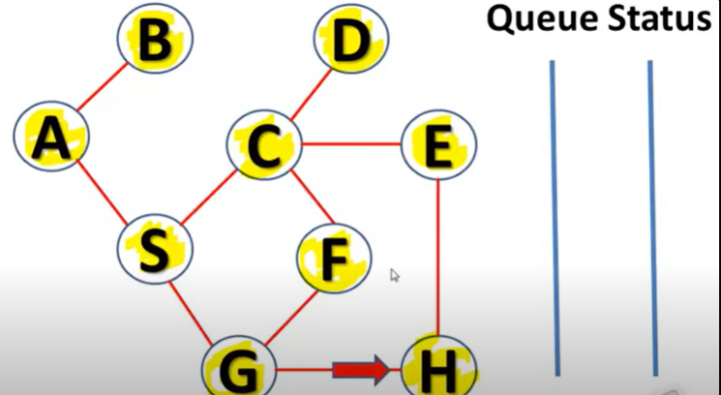
Output: ABSCGDEFH

Slide 18
Time Complexity: Time Complexity of BFS algorithm can be obtained by the number of nodes traversed in BFS until the shallowest Node. Where the d= depth of shallowest solution and b is a node at every state.
T (b) = 1+b²+b³+.......+ b^{d}= O (b^{d})
Space Complexity: Space complexity of BFS algorithm is given by the Memory size of frontier which is O(b^{d}).
Completeness: BFS is complete, which means if the shallowest goal node is at some finite depth, then BFS will find a solution.
Optimality: BFS is optimal if path cost is a non-decreasing function of the depth of the node.

Slide 19
Depth-first search
Pick one path and follow it as far as possible. Only when you hit a dead end do you backtrack and try the next option.
Real-world example: Solving a corn maze by always turning the same direction at every junction and committing to that path until you hit a wall, then backing up to the last junction to try another turn. You might take a long, roundabout route before finding the exit.

Slide 20
Depth-first search
A search strategy that extends the current path as far as possible before backtracking to the last choice point and trying the next alternative path is called Depth-first search (DFS).
This strategy does not guarantee that the optimal solution has been found.
The search reaches a satisfactory solution more rapidly than breadth first, an advantage when the search space is large.
Algorithm
Depth-first search applies operators to each newly generated state, trying to drive directly toward the goal.
1. If the starting state is a goal state, quit and return success.
2. Otherwise, do the following until success or failure is signaled:
a. Generate a successor E to the starting state. If there are no more successors, then signal failure.
b. Call Depth-first Search with E as the starting state.
c. If success is returned signal success; otherwise, continue in the loop.

Slide 21
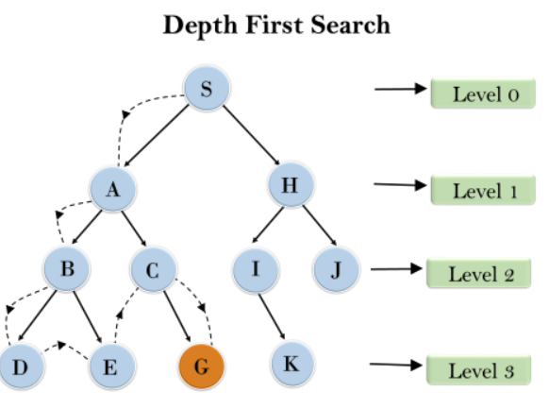
Example
Root node--->Left node ----> right node.
It will start searching from root node S, and traverse A, then B, then D and E, after traversing E, it will backtrack the tree as E has no other successor and still goal node is not found. After backtracking it will traverse node C and then G, and here it will terminate as it found goal node.

Slide 22
Advantages
1. Low storage requirement: linear with tree depth.
2. Easily programmed: function call stack does most of the work of maintaining state of the search.
Disadvantages
1. May find a sub-optimal solution (one that is deeper or more costly than the best solution).
2. Incomplete: without a depth bound, may not find a solution even if one exists.

Slide 23
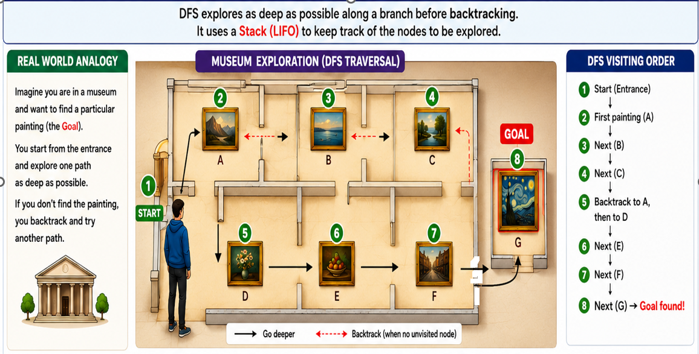

Slide 24
Completeness: DFS search algorithm is complete within finite state space as it will expand every node within a limited search tree.
Time Complexity: Time complexity of DFS will be equivalent to the node traversed by the algorithm. It is given by:
T(n)= 1+ n²+ n³ +.........+ n^{m}=O(n^{m})
Where, m= maximum depth of any node and this can be much larger than d (Shallowest solution depth)
Space Complexity: DFS algorithm needs to store only single path from the root node, hence space complexity of DFS is equivalent to the size of the fringe set, which is O(bm).

Slide 25
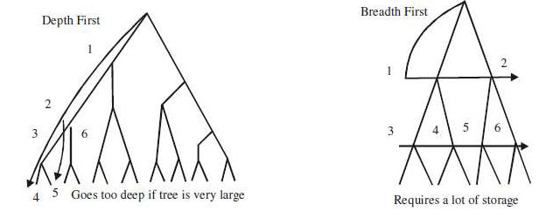

Slide 26
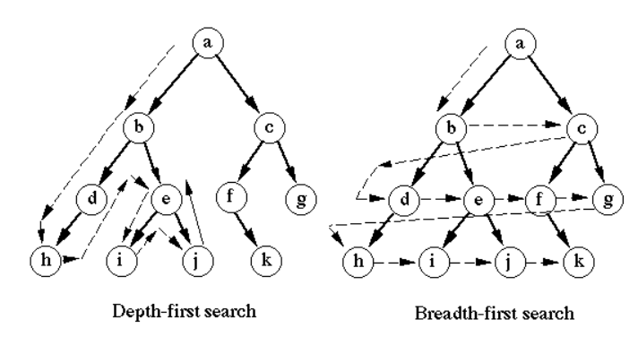

Slide 27
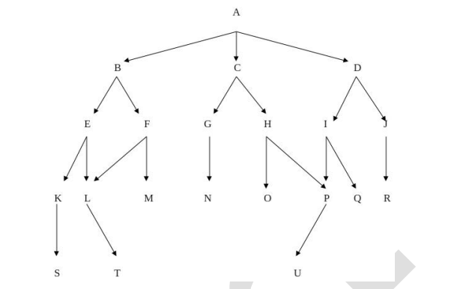
Apply BFS and DFS to trace the goal node U from initial node A.

Slide 28
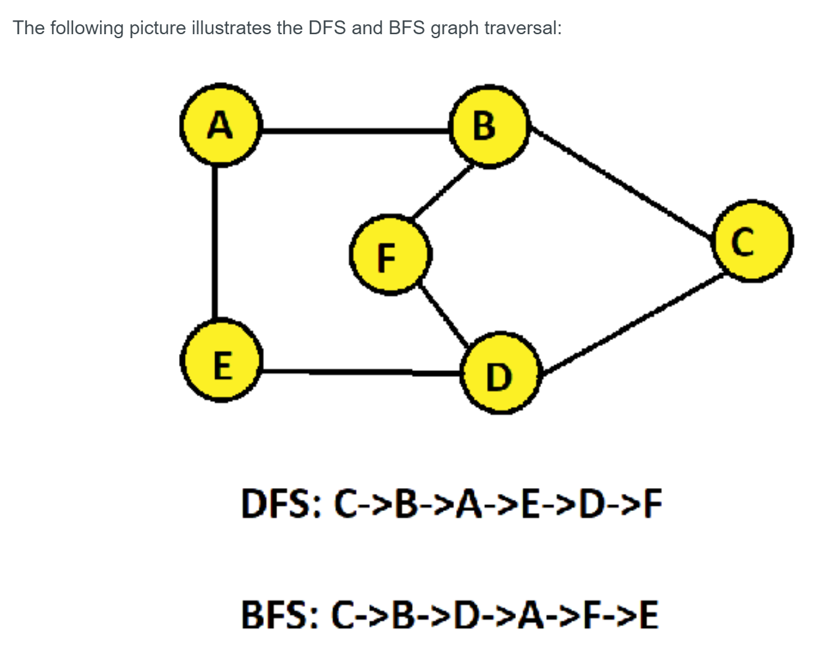

Slide 29
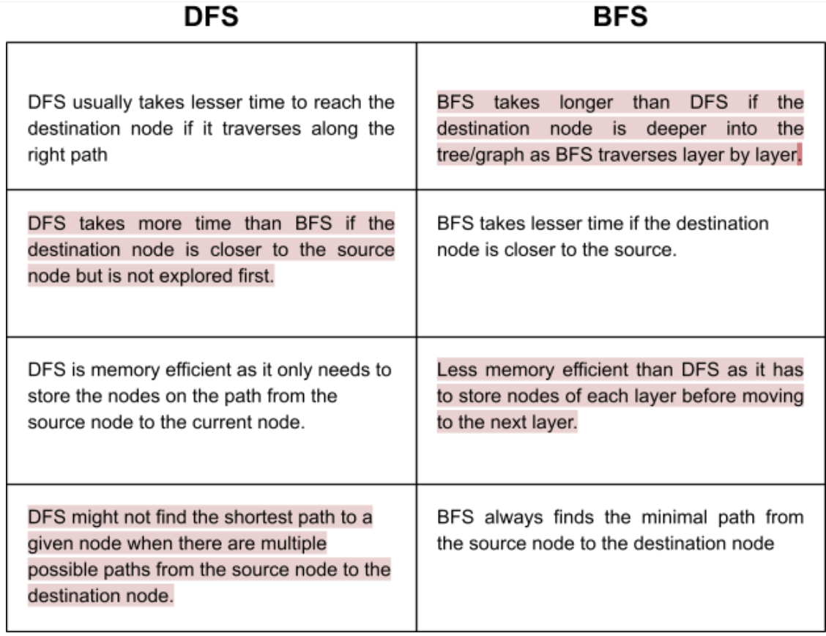
Drawbacks of DFS and BFS

Slide 30
Depth first limit search (DLS)
DFS with a "curfew" — you are only allowed to go down to a certain depth before being forced to turn back, even if you haven't hit a dead end.
Real-world example:
Searching your house for your keys but limiting yourself to 3 levels deep: bedroom, then closet, then shoebox. You won't check inside a smaller box tucked inside that shoebox.
Used in robotics path planning, network routing (limiting hops), and puzzle solving where searching too deep wastes time.

Slide 31
Depth first limit search (DLS)
Depth Limited Search is a modified version of DFS that imposes a limit on the depth of the search. This means that the algorithm will only explore nodes up to a certain depth, effectively preventing it from going down excessively deep paths that are unlikely to lead to the goal. By setting a maximum depth limit, DLS aims to improve efficiency and ensure more manageable search times.
How Depth Limited Search Works
Initialization: Begin at the root node with a specified depth limit.
Exploration: Traverse the tree or graph, exploring each node’s children.
Depth Check: If the current depth exceeds the set limit, stop exploring that path and backtrack.
Goal Check: If the goal node is found within the depth limit, the search is successful.
Backtracking: If the search reaches the depth limit or a leaf node without finding the goal, backtrack and explore other branches.

Slide 32
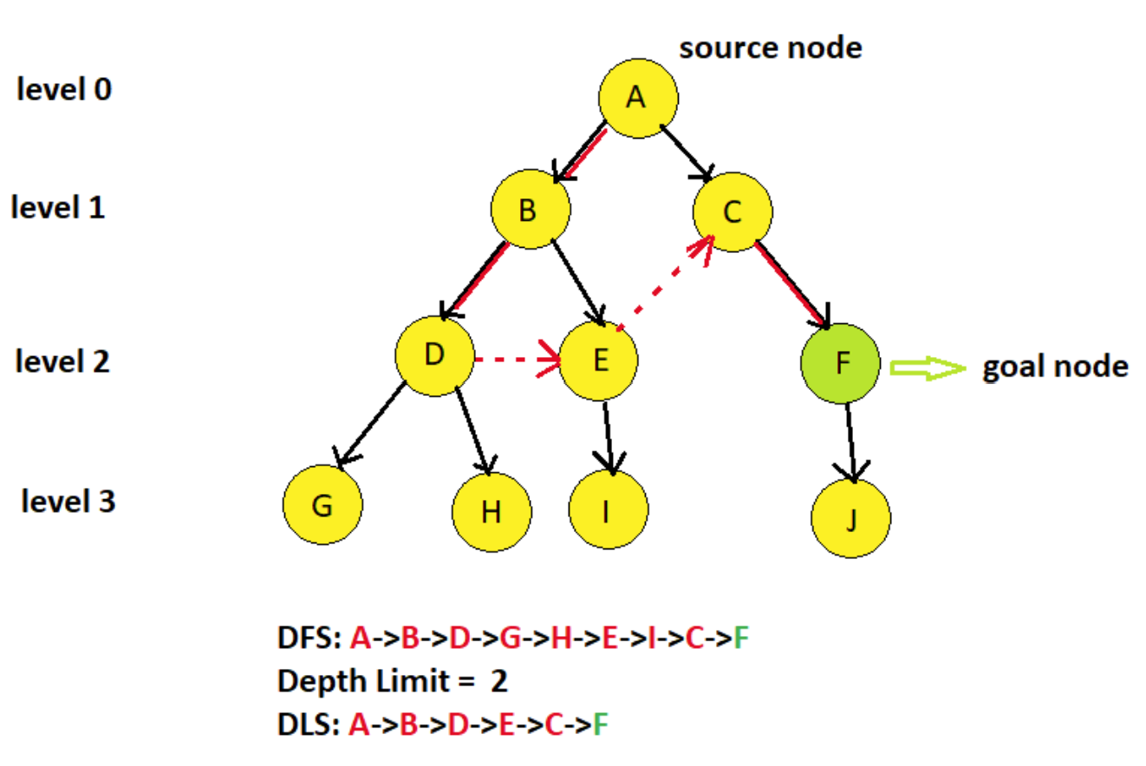
DLS

Slide 33
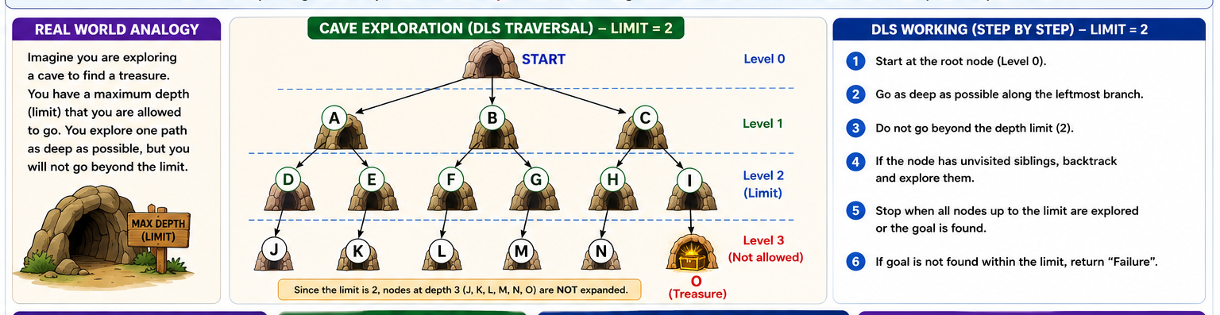

Slide 34
Applications of Depth Limited Search in AI
Pathfinding in Robotics: DLS is employed for nonholonomic motion planning of robots in the presence of obstacles. By imposing restriction on the depth it makes the robot stop after exploring a particular depth of an area and restricting the robot from too much wandering.
Network Routing Algorithms: A DLS can be implemented to compute paths between nodes in computer networks restricting the number of hops to prevent loops.
Puzzle Solving in AI Systems: DLS can be used to solve puzzles such as the 8-puzzle or Sudoku by manipulating possible moves a fixed number of times that reduces how many steps are taken in the search.
Game Playing: In AI for games, instead, DLS can be used to plan forward a few moves up to a certain level of depth to help decide how much effort to put into a given decision.
DFS can be used for various tasks, including searching for a path between two nodes, traversing a tree or graph to visit all nodes, or solving certain types of puzzles. It’s often used as a building block in more complex algorithms and AI applications, such as solving mazes, analyzing game states, or exploring decision trees in search algorithms like minimax for games like chess or tic-tac-toe.

Slide 35
Iterative Deepening Depth-First Search (IDDFS)
Run depth-limited search with limit 0, then limit 1, then limit 2, and so on — increasing the curfew each time until the goal is found. It re-searches shallow areas repeatedly, but combines DFS's low memory use with BFS's guarantee of the shortest solution.
Real-world example: Searching for your keys by gradually expanding your search radius: first just the doorway, then one step in, then two steps in — never risking a very deep search too early.

Slide 36
Iterative Deepening Depth-First Search (IDDFS)
The Iterative Deepening Depth-First Search (or Iterative Deepening search) algorithm, repeatedly applies depth-limited search with increasing limits.It gradually increases limits from 0,1,...d, until the goal node is found.
It terminates in the following two cases:
When the goal node is found
The goal node does not exist in the graph/tree.

Slide 37
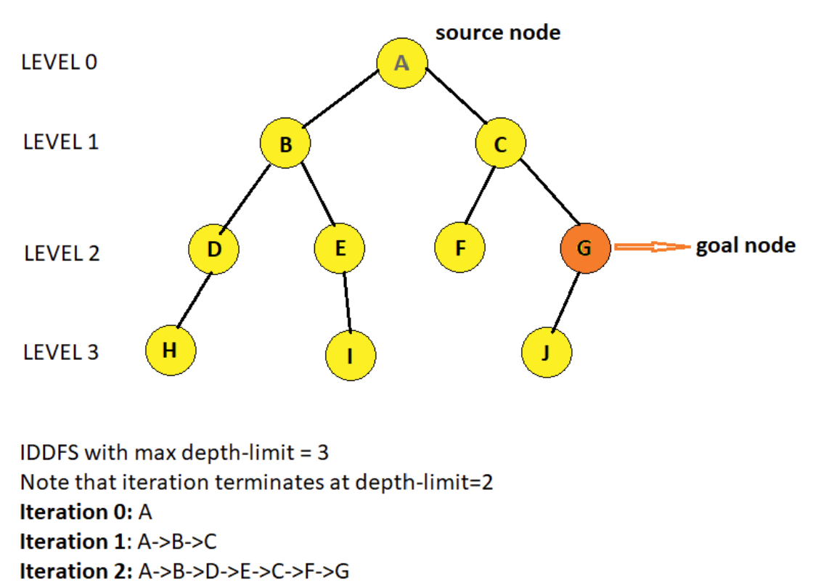
IDDFS

Slide 38
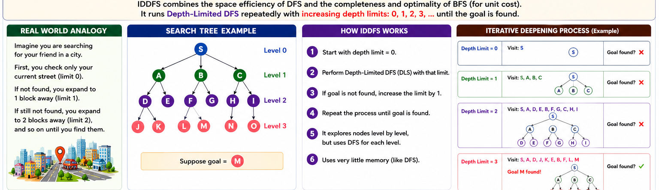

Slide 39
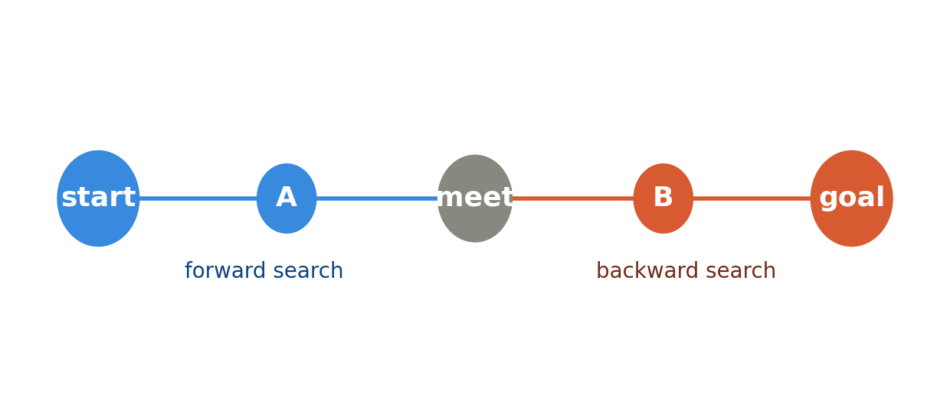
Bidirectional Search Algorithm:
Search from both ends at once: one search moves forward from the start, another moves backward from the goal. The search stops as soon as the two meet in the middle.
Real-world example: Two friends trying to meet up in a large, unfamiliar city. Instead of one person walking the whole route alone, both start walking toward each other, cutting the total search time roughly in half.

Slide 40
Bidirectional Search Algorithm:
Bidirectional search algorithm runs two simultaneous searches, one from initial state called as forward-search and other from goal node called as backward-search.
It replaces one single search graph with two small subgraphs in which one starts the search from an initial vertex and other starts from goal vertex. The search stops when these two graphs intersect each other.
Bidirectional search can use search techniques such as BFS, DFS, etc.

Slide 41
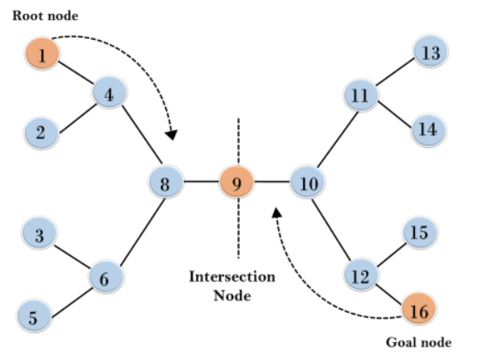
Example:
This algorithm divides one graph/tree into two sub-graphs. It starts traversing from node 1 in the forward direction and starts from goal node 16 in the backward direction.
The algorithm terminates at node 9 where two searches meet.

Slide 42
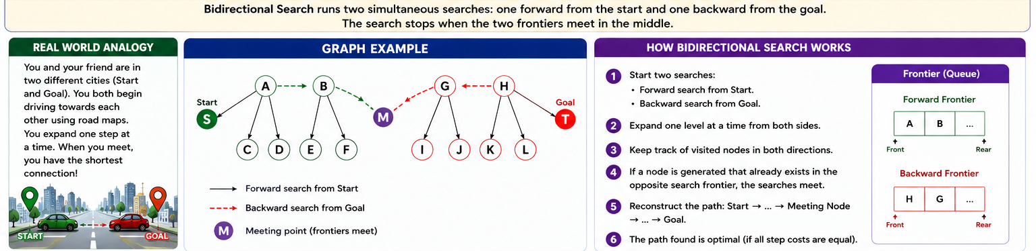

Slide 43
Advantages:
Bidirectional search is fast.
requires less memory
Disadvantages:
Implementation of the bidirectional search tree is difficult.
one should know the goal state in advance.

Slide 44
Completeness: Bidirectional Search is complete if we use BFS in both searches.
Time Complexity: Time complexity of bidirectional search using BFS is O(b^{d}).
Space Complexity: Space complexity of bidirectional search is O(b^{d}).
Optimal: Bidirectional search is Optimal.

Slide 45
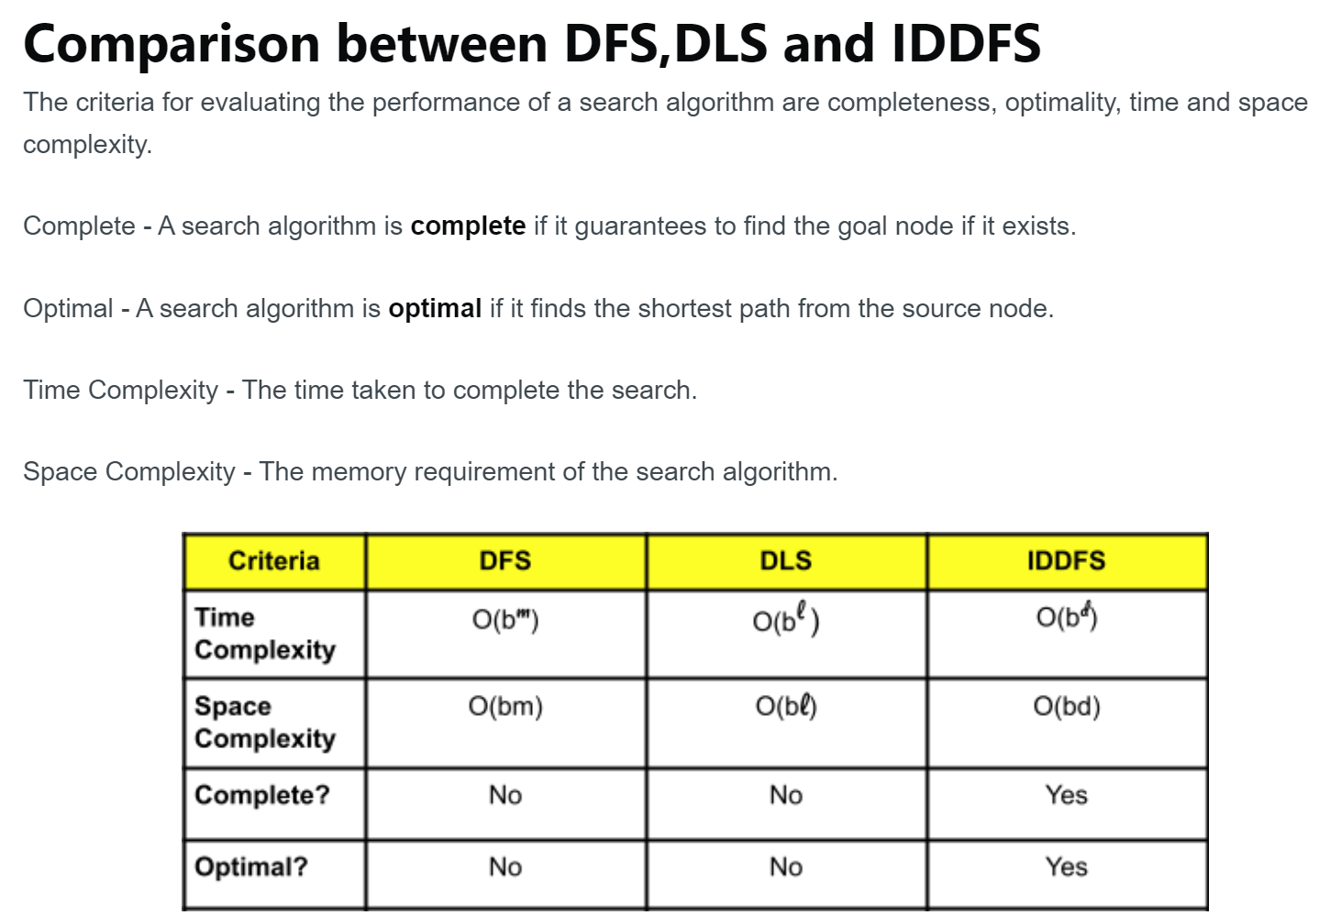

Slide 46
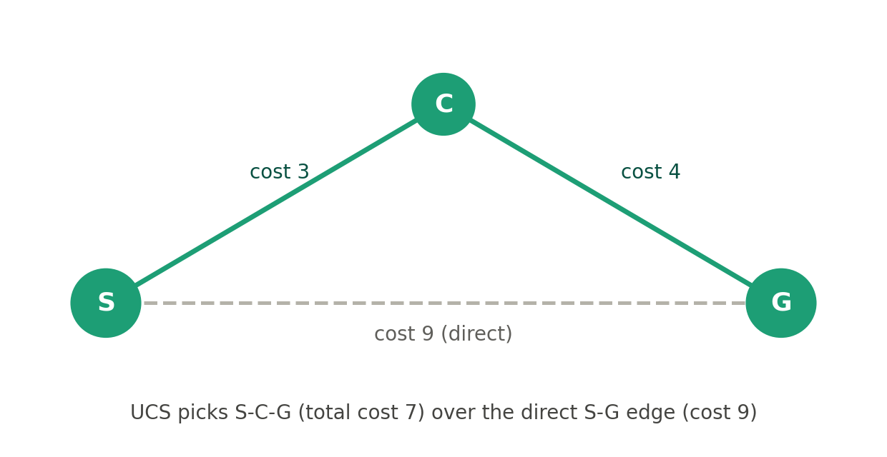
Uniform cost method
Instead of counting steps, UCS counts cost. It always expands the cheapest unexplored path so far — not necessarily the one with fewest steps, but the one that costs the least overall.
Real-world example: Choosing a driving route by total toll or fuel cost rather than number of turns. A route with fewer turns might actually cost more if it passes through an expensive toll road, so UCS always follows whichever path has spent the least money so far.

Slide 47
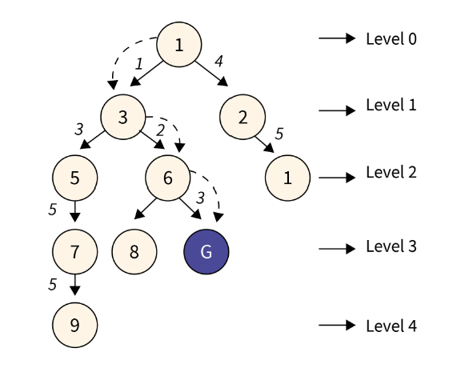
Uniform cost method
The Uniform Cost Search Algorithm is a search algorithm to find the minimum cumulative cost of the path from the source node to the destination node.
It is an uninformed algorithm i.e. it doesn't have prior information about the path or nodes and that is why it is a brute-force approach.

Slide 48
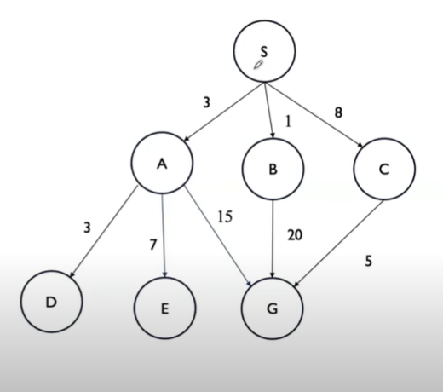

Slide 49
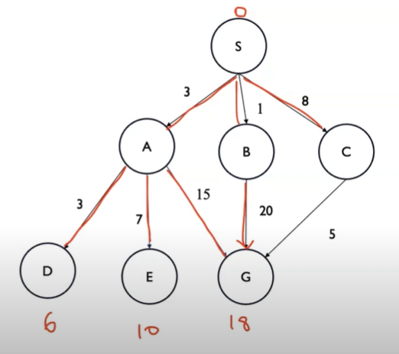
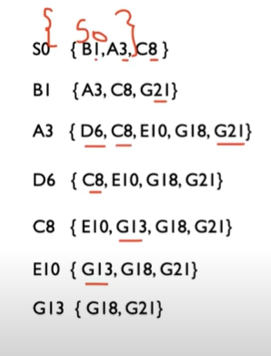
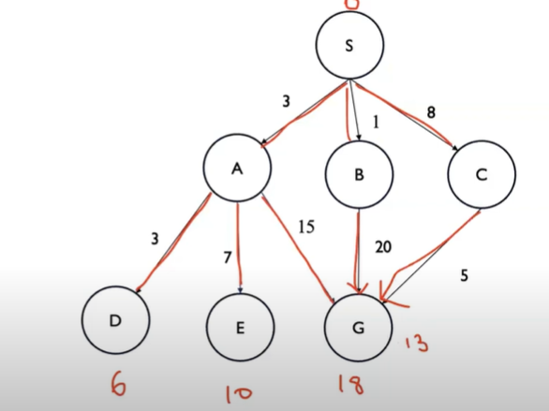
Path: S – C – G
Cost:13
No. of nodes expanded : 7

Slide 50
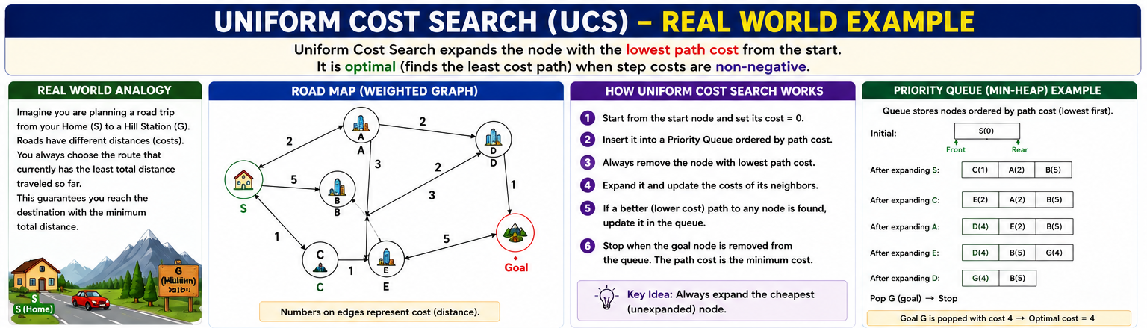

Slide 51
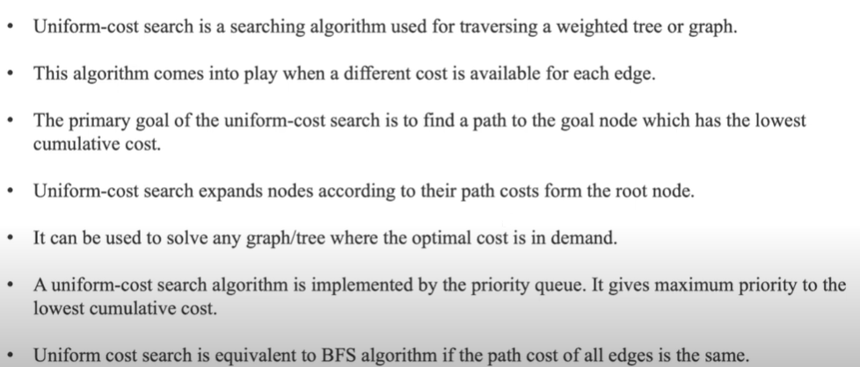
Uniform Cost Search Algorithm

Slide 52
Algorithm
Create a priority queue, a boolean array visited of the size of the number of nodes, and a min_cost variable initialized with maximum value. Add the source node to the queue and mark it visited.
Dequeue the element with the highest priority from the queue. If the removed node is the destination node, check the min_cost variable, if the value of the min_cost variable is greater than the current cost then update the variable.
If the given node is not the destination node then add all the unvisited nodes to the priority queue adjacent to the current node.

Slide 53
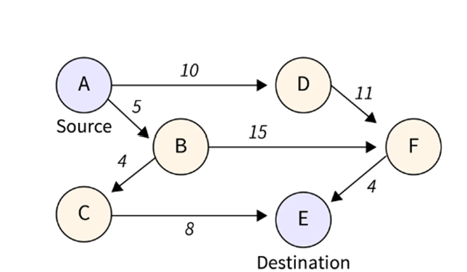
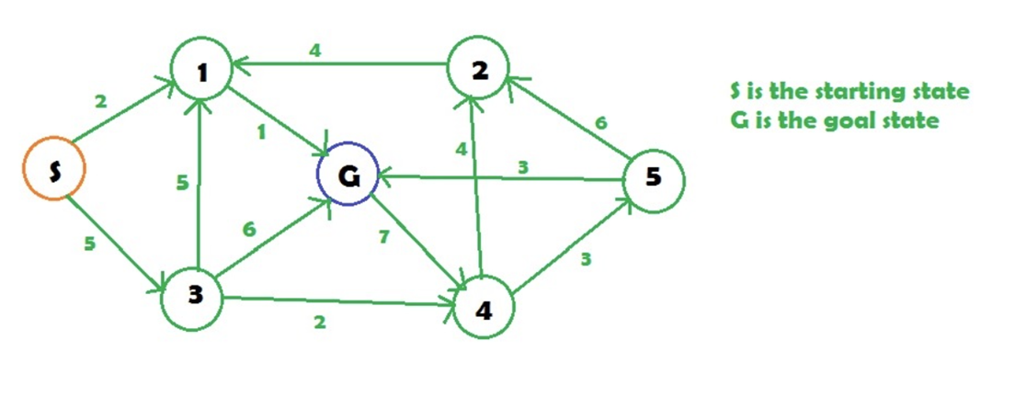

Slide 54
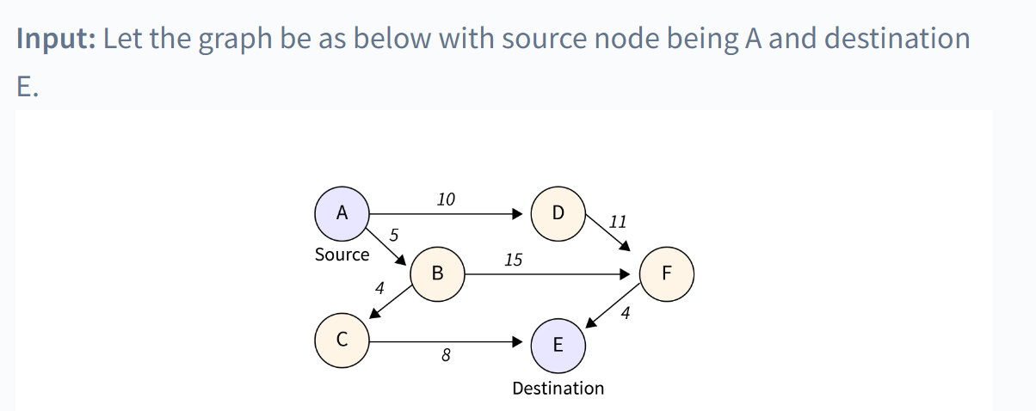
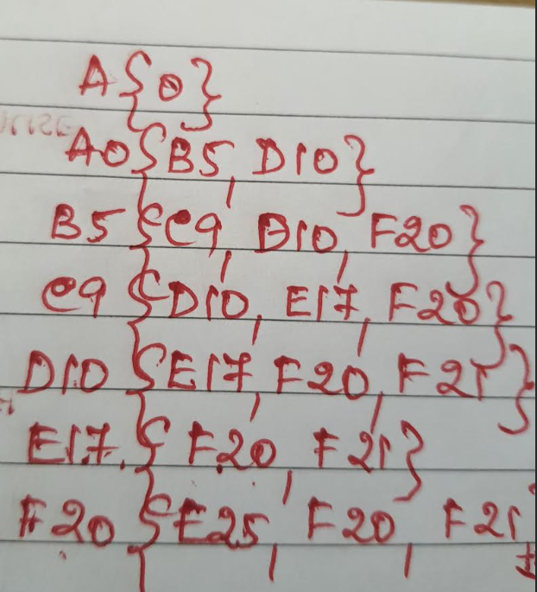
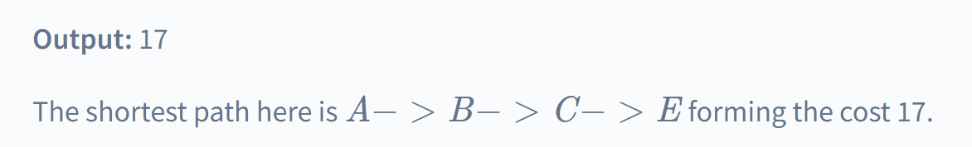
Apply the UCS to the weighted graph and find the shortest path, the cost and the no. of expanded nodes.

Slide 55


Slide 56
Comparision
Algorithm | Memory use | Finds shortest/cheapest? | Best when...
BFS | High | Yes (fewest steps) | Goal is shallow; all steps cost the same
DFS | Low | Not guaranteed | Memory is limited; deep solutions are okay
Depth-Limited (DLS) | Low | Not guaranteed | You have a rough idea of solution depth
Iterative Deepening (IDDFS) | Low | Yes (fewest steps) | You want BFS's guarantee with DFS's memory
Bidirectional | Medium | Yes (with BFS) | You know both the start and goal exactly
Uniform Cost (UCS) | High | Yes (cheapest cost) | Steps have different costs (tolls, distances)

Slide 57

Comparison

